Slide 1

DriverPass System Analysis
Mike Brown
Notes:
Hi, I’m Mike Brown. I’ll be walking you through the design for the DriverPass system. This presentation gives a quick overview of what the system does, how it works for your users, and the design choices that help make it secure and easy to use. My goal was to take your requirements and turn them into something that’s both practical and efficient for your students, instructors, and staff.

Slide 2

System Requirements
Functional Requirements
Students can schedule, cancel, or reschedule driving lessons online.
The system tracks student progress and stores completed tests.
Nonfunctional Requirements
The website works on both computers and mobile devices.
All data is secured through encrypted connections.
Notes:
When I started defining what DriverPass needed, I broke it down into two parts: what the system actually does and how it’s supposed to perform.
For what it does, the main functions are pretty simple. Students should be able to create an account, buy a lesson package, schedule or cancel lessons online, and view their progress as they complete practice tests and lessons. These features make things faster and less stressful for both students and office staff.
For how it performs, I focused on accessibility and safety. The site needs to work on phones, tablets, or computers, so users can log in wherever they are. It also has to keep personal data secure, especially when it comes to payments. By designing it this way, DriverPass can handle more users without creating extra work for the staff or risking customer information.

Slide 3
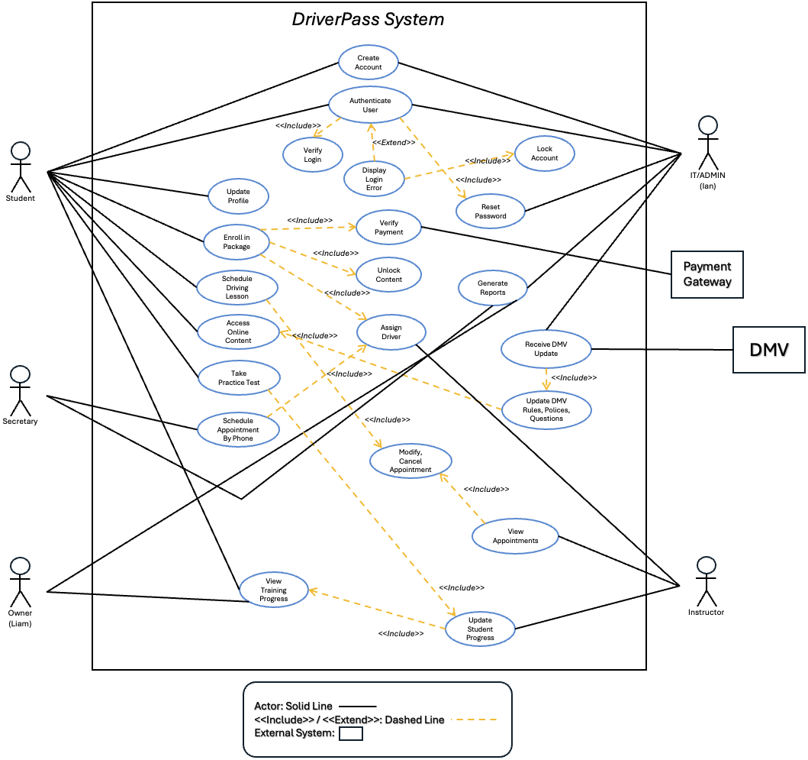
Use Case Diagram
Notes:
This visual shows who uses the system and what they can do.
Students can sign in, pick their lesson packages, schedule their sessions, and take practice tests. Instructors review their assigned lessons and record each student's performance. The admin team manages accounts, updates packages, and pulls reports. The system also connects to the DMV, so the practice test information stays up to date, and to the payment service that processes transactions.
I designed it so everyone has a clear role. It helps keep the system organized and prevents confusion about who can access what.

Slide 4
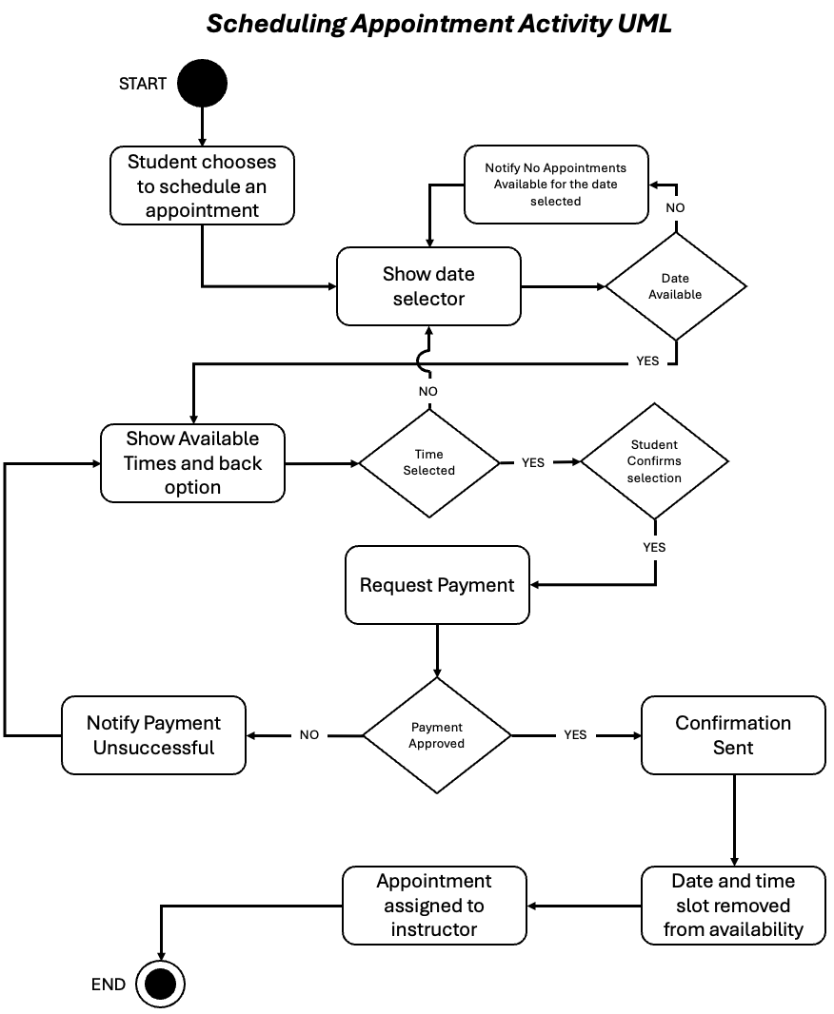
Activity Diagram
Notes:
This diagram walks through how a student books a lesson. It starts with the student choosing a time. The system checks if that slot is free and if the student has any remaining lessons in their package. Once it confirms everything, it finalizes the booking, assigns an instructor, and sends out confirmation messages.
If the time isn’t available, the student can pick another time without having to call the office. This process reduces mistakes and gives students more flexibility. It also helps instructors and vehicles stay on schedule.

Slide 5
Security
User login with password protection
HTTPS and TLS encryption for all web traffic
Account lockout after multiple failed logins
Role-based access for staff and students
Regular data backups and monitoring
Notes:
Security is built into every part of the system. All data is sent through secure HTTPS connections using TLS. Passwords are hashed and never stored in plain text. There’s also an automatic lockout feature that kicks in if someone fails to log in too many times. Each user type—student, instructor, or admin—has access only to the parts they need. Regular backups make sure information is never lost.

Slide 6
System Limitations
Requires reliable internet access
Relies on DMV and payment systems for some data
Some mobile devices may display content differently
Future expansion may need more server resources
Notes:
Even with a solid design, there are a few normal limits. Because DriverPass runs online, users need a steady internet connection to log in and schedule lessons. Some parts, like payments or DMV updates, rely on external systems, so short delays may occur if those services are down. The system also depends on the devices people use, so screens may look slightly different on smaller phones. Finally, if DriverPass grows quickly, the company may need to add more server space to keep everything running smoothly. These are all manageable as the program expands.

Slide 7
Summary
DriverPass System Summary
Simple for students and staff to use
Online scheduling and progress tracking
Secure logins and protected data
Reduces admin time and errors
Designed to grow with the business
Notes:
To wrap everything up, this design gives DriverPass a system that’s easy to use, secure, and built to grow.
Students will be able to handle almost everything on their own—signing up, booking lessons, and checking their progress—without needing to call or wait on staff. Instructors and administrators get better tools for managing schedules and tracking results, saving time and reducing mistakes.
Security and privacy were major priorities, so every login and data exchange is protected. The design also keeps things flexible, so new features or updates can be added later as the business grows.
Overall, this system helps DriverPass achieve its goal of making driver education more straightforward, organized, and reliable for everyone involved.

